Slide 1
AskHR: HR Policy Assistant
Brightpath doesn't lack HR policies. It lacks one trusted answer for the person asking.
Ashokkumar
27 October 2026
Notes:
Open with the punchline: the policies exist, but nobody can get the right one for their country, grade and contract without asking a person. AskHR fixes that and hands everything sensitive to a human.

Slide 2
HR partners spend 40% of their time on answered questions
2,500
1.5 days
40%
8%
policy questions a month, peaking near 4,000 in March (India tax) and November (US open enrolment)
average wait for a reply on a question the policy already answers
of HR partner time spent on repeat questions, across 12 HRBPs in 3 countries
of answers wrong in audit, mostly another country's policy or a superseded version
Cost today: 18 minutes and $10.50 per question, about $26k a month. 10% of India questions arrive in Hindi or Hinglish, and 700 contractors are on different terms from employees. Sensitive questions (harassment, health, layoffs) sit in the same queue, so people avoid asking them.
CHRO goal in 6 months: 60% of policy questions resolved without an HR partner; repeat-question time from 40% to 20%.
Source: Product brief (Brightpath HR, 6,000 employees: India 3,600, UK 1,200, US 1,200).
Notes:
Four numbers from the brief. The cost is not just $26k a month: employees wait a day and a half, and 1 in 12 answers is wrong.

Slide 3
Discovery: the right answer depends on who is asking
PRIMARY PERSONA
"I answer the same twenty questions every week, and I still have to look up which version is live."
Meera Iyer, HR business partner, Bengaluru
HR partner, India
"Two travel policies are live at once. I don't know which hotel limit to quote."
Supports about 600 employees; one of 12 HRBPs
Answers leave, pay-date, benefits and travel questions by email, Teams and ServiceNow
Checks Workday for country, grade and contract on every question
Goal: spend her time on the sensitive cases only a person should handle
Employee, London
"I didn't want to ask about medical leave in a ticket everyone in HR can read."
Employee, US
"If the bot says 'you get 10 more days', that reads as a promise in the UK."
Legal, UK
Notes:
Meera is the persona from Problem Discovery. The quotes are illustrative voices based on the brief's findings, not verbatim interviews.

Slide 4
Five whys: policy knowledge was never run as a product
1
2
3
4
5
Repeat questions
Employees can't self-serve
Answer depends on who asks
Versions are unclear
No publishing process
Every routine question is a ticket a person reads and answers by hand.
300 pages in 40 documents, with no search by country, grade or contract.
Nothing joins the Workday profile to the right policy section.
No owner or effective dates; superseded files stay visible (8% wrong).
No owner, audience or dates per document; no channel that delivers them.
ROOT CAUSE
Brightpath has no single, version-controlled policy source joined to who is asking. Fix: publish policies with owner, audience and effective dates, and answer from them by profile, with every sensitive case going straight to a named person.
Notes:
Walk the chain quickly; land on the root cause box. That is why the fix is a governed source plus a profile-aware assistant, not a chatbot on SharePoint.

Slide 5
The gap shows up at every step of today's workflow
Step | What happens today | Where it breaks | Opportunity
1. Employee asks | Email, Teams or ServiceNow, often in Hinglish | Waits 1.5 days; avoids sensitive questions | O1, O9
2. Who is asking? | HRBP checks Workday by hand | Contractors given employee terms | O2
3. Find the policy | Search 40 SharePoint documents, scanned PDFs, tables | Two live travel versions; superseded files (8% wrong) | O3, O4
4. Personal data | Workday for balance and joining date | Balance questions always need a person | O8
5. Reply and log | Write answer, paste link, log ticket | 18 minutes each; peaks swamp the team | O1, O5
6. Sensitive cases | Harassment, medical, layoff in the same queue | Wait behind routine questions; read as promises | O6, O7
7. Policy updates | About 10 a quarter, no format or owner | Nobody knows which version is live | O4, O11
Source: Problem Discovery and AI Opportunity Map (Miro frame 2).
Notes:
This is the Miro workflow frame in one table. Steps 2, 3 and 6 are where wrong answers and lost trust come from.

Slide 6
We scored 15 AI opportunities and built the seven Do-first ideas
Built: the seven Do-first ideas
Answers, eligibility and version filters, triage, redaction and the verification guard together hit the 60% goal without risking a wrong answer.
Parked on purpose
Auto-answering from old tickets copies the 8% error rate. AI never handles grievances or gives legal opinions. Predicting attrition from chats would destroy trust.
Notes:
Impact x feasibility, each 1 to 5. Two of the top scorers are mostly code, not AI: the eligibility filter and the verification guard. That is deliberate.

Slide 7
Four features, one rule: people handle the sensitive cases
F1
F2
F3
F4
Grounded answers
Profile and version filter
Safety triage and hand-off
Verification guard
Short answer from the employee's live policy, with a link to the exact section. Grade and service tables personalised.
Country, grade and contract come from Workday, never the chat. Other countries and old versions are removed before search.
Harassment, health, layoff, legal and pay problems go to a named HR queue with a summary. The employee approves; crisis goes at once.
Every answer must cite a retrieved section, every number must appear in it, and there are no promises or legal advice.
Opportunity O1, O3
Opportunity O2, O3
Opportunity O6, O7
Opportunity O5
Rules before AI. Sensitive messages are caught by rules before any model call, so they never reach an AI provider. If no live policy matches, AskHR says so and offers an HR partner. It never guesses, never approves leave, and never changes pay.
Notes:
Each feature maps to an opportunity on the Miro board. The rule at the bottom is the design principle Legal and the HRBPs signed up for.

Slide 8
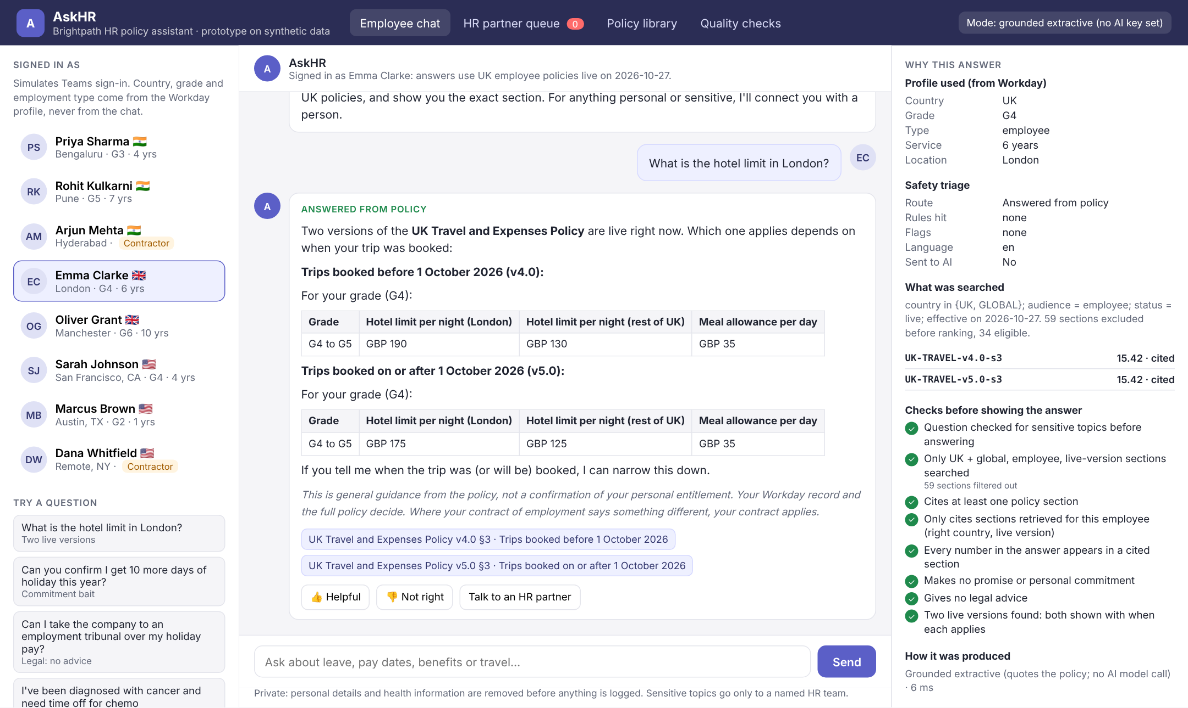
Emma asks about London hotels: two live versions, both cited
1
Profile from Workday
UK, G4, employee, 6 years. Never taken from the chat.
2
Both live versions
v4.0 and v5.0 shown with the booking date that decides which applies.
3
Exact section links
Every answer cites the policy section it came from.
4
Checks before showing
Own country only, numbers grounded, no promise, no legal advice.
Live prototype: askhr-policy-assistant.vercel.app (synthetic data, grounded extractive mode).
Notes:
Live demo moment. Emma is G4 in London. The UK travel policy is mid-transition, so AskHR shows both versions with the date that decides which applies, instead of guessing.

Slide 9
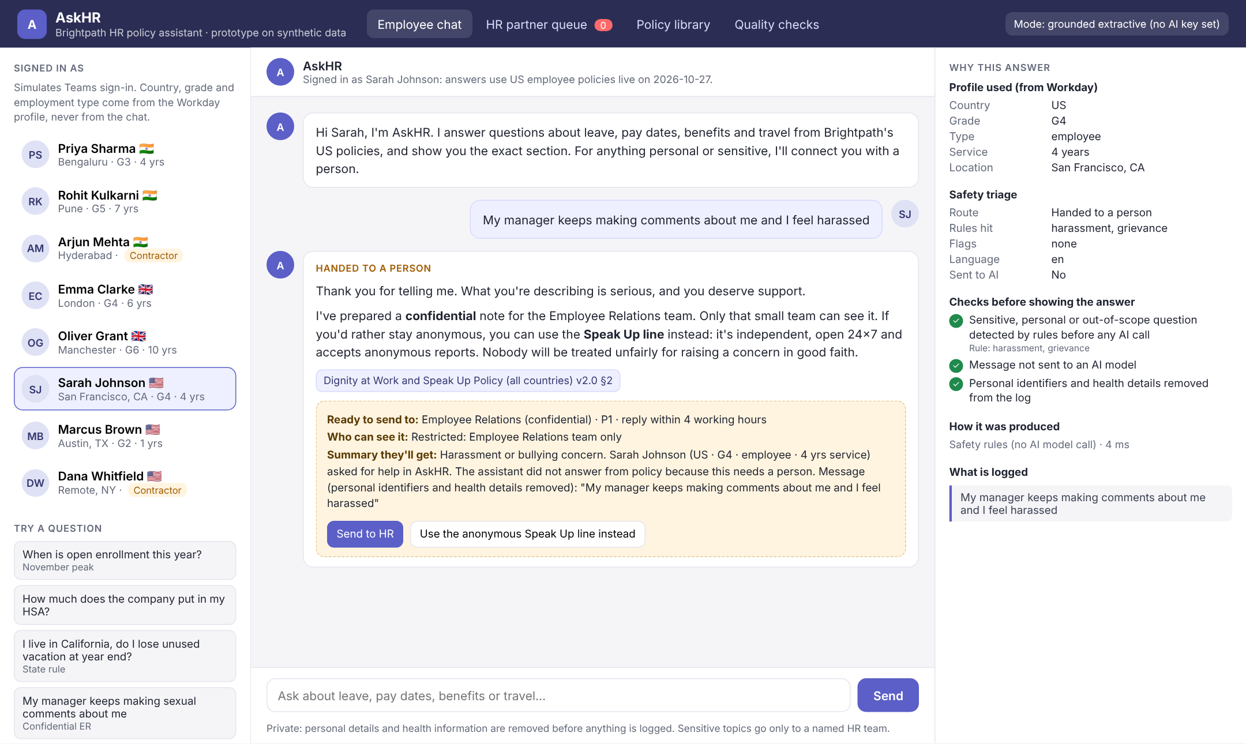
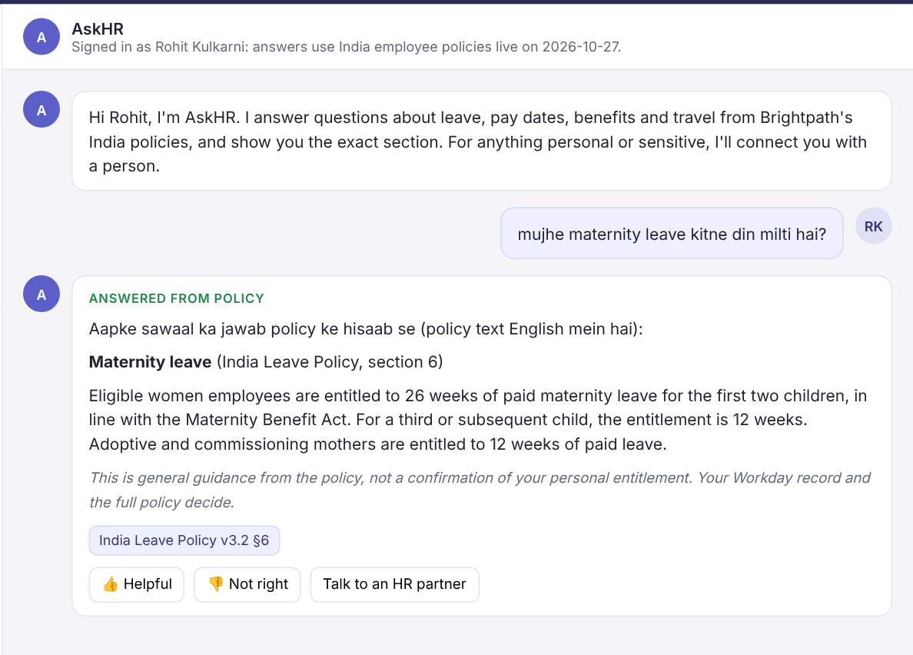
Sensitive questions reach a person; Hinglish gets an answer
Handed to a person. Harassment goes to Employee Relations only, P1 within 4 working hours. Sarah sees who can read it and can choose the anonymous Speak Up line instead. The message is never sent to a model.
Answered in context. 10% of India questions come in Hindi or Hinglish. AskHR understands them and cites the live India Leave Policy v3.2, never the superseded v3.1.
Notes:
Left: Sarah reports harassment. No AI call; a confidential ticket for Employee Relations, approved by her, with the anonymous Speak Up line offered. Right: Rohit asks in Hinglish and gets the India maternity policy with a Hinglish lead line.

Slide 10
Rules where possible, models where needed: under a cent each
Profile
Country, grade, contract from Workday
Code
$0.0007 per question
Triage
Sensitive, legal, pay problems handed off
Rules
About $2 a month in model calls at 2,500 questions, and about $152 a month all-in with hosting, search and monitoring. The extractive fallback costs nothing.
Filter
Own country, live version, audience
Code
Retrieve
Rank policy sections (BM25 + synonyms)
Search
Business case at 60% resolved
$15.2k a month net saving ($182k a year)
2.6 HR partner FTE freed for sensitive cases
Payback in about 3 months on an assumed $48k build
Answer
Short cited answer as JSON
Grok, Claude fallback
Verify
Citation, numbers, no promise, no legal advice
Code
Source: Cost Estimation workbook (3,110 input + 250 output tokens per call; Grok 95%, Claude 5%).
Notes:
Most of the pipeline is deterministic code. The model only writes the wording, and the guard checks it. If the guard fails, AskHR quotes the policy instead.

Slide 11
North Star: correctly resolved self-service, 0% to 60%
Supporting metrics: target
HR partner time on repeats
40% → 20% by month 6
Time to first answer
1.5 days → under 10 seconds
Wrong answers (weekly audit)
8% → under 1%
Wrong-country or old-version citations
0, always
Sensitive questions reaching a person
100%
Answers rated helpful
85% or more
Notes:
The North Star only rises when answers are both used and right: a thumbs-down, hand-off or reopen within 7 days does not count. Guardrails keep it honest.

Slide 12
Leading signals tell us early; the business outcome follows
Lagging: outcomes the CHRO cares about
LEADING: CHECK WEEKLY
Correctly resolved self-service rate
HR partner time on repeats
Time study plus ServiceNow volume
40% → 20%
Questions answered per week, by country and topic
Thumbs-up rate and repeat use within 60 days
Hand-offs HR partners accept without re-asking (80% target)
'Not found' questions: the weekly content gap list for policy owners
Cost of answering
$10.50 per question today; about $26k a month
≈ $15k a month saved
Peak-season backlog
March (India) and November (US) queues
No backlog over 1 day
Employee CSAT on HR answers
Post-answer survey
4.3 / 5 or better
Counter-metric: wrong-answer rate in a weekly audit of 100 answers. Above 3% means rollback.
Notes:
We review the leading metrics weekly in the pilot. If thumbs-up drops or hand-off acceptance falls, we fix content before scaling.

Slide 13
Evals gate every deploy: a failed guardrail blocks the release
Launch gates: 100%
Sensitive hand-off, own-country citations, no superseded versions, grounding and privacy must all be 100% on both sets, or the build fails.
Model guard test: 6 / 6
Fake model replies with an invented number, a promise, an old or other-country citation, or no citation are all blocked before an employee sees them.
80 labelled questions incl. Hindi, Hinglish, contractor, legal, prompt injection and commitment bait. Held-out set written after tuning.
Notes:
These are real results from the prototype build. The two held-out misses are quality misses in extractive mode, not safety failures; model mode exists to close them.

Slide 14
Risks we design for, and the guardrail for each
RISK
GUARDRAIL
Wrong country or old version
Eligibility filter in code before ranking; superseded versions removed; 100% eval gate
The 8% we inherit
Answer reads as a promise
No-commitment wording on every answer; 'your contract applies' in the UK; guard blocks promises
Legal, especially UK
Sensitive message mishandled
Rules before AI; never sent to a model; restricted Employee Relations queue; crisis sent at once
Harassment, health, crisis
Invented numbers
Every number must appear in a cited section, else AskHR quotes the policy instead
Hallucination
Personal data leaks
Identifiers and health terms removed from logs; approved vendors only; 90-day retention
UK GDPR, India DPDP
HRBPs lose trust
Hand-off summaries they accept without re-asking; weekly content-gap report to policy owners
Adoption
Notes:
Each risk has a guardrail in the product and a gate in the evals. The rollback triggers are in the PRD.

Slide 15
Rollout: India before March, the US before November
PRD sign-off 13 Nov 2026. Build sprints to 8 Jan 2027 with the eval gate in CI.
1
Jan 2027
2
Feb 2027
3
Mar to Apr 2027
4
By Sep 2027
Alpha
India beta
Phased rollout
Full release
12 HR partners and 3 country leads, 2 weeks on real questions
500 employees in Bengaluru
All India, then UK, then US
6,000 employees and 700 contractors
GATE
GATE
GATE
GATE
95% of 150 answers rated correct; Legal signs off wording
Wrong answers under 1%; 100% sensitive hand-off; 80% helpful
40% self-service; 80% hand-offs accepted; March peak handled
North Star trending to 60%; balance lookup approved by Security
Notes:
Each stage has a gate. We don't move on until the gate is met.

Slide 16
Next: three decisions to start the alpha
1. Approve xAI and Anthropic (zero data retention), or name an approved alternative.
2. Name one publishing owner per policy document in each country.
3. Legal to approve the no-commitment wording for India, UK and US.
Live prototype: askhr-policy-assistant.vercel.app
Ashokkumar · 27 October 2026
Notes:
Close on the asks. With these three answers, the alpha with HR partners can start in January.

